Slide 1
Tamil Nadu District Wise Power Consumption Analysis
Chandragiri Praveen Gandhi

Slide 2
Agenda
Introduction
2017 - 18 District wise Analysis
2018 - 19 District wise Analysis
Comparison between 2017 - 18 & 2018 - 19 Common Districts
Choropleth Visualizations
References & Links

Slide 3
Key Terms
Power Consumption - Power consumption is the amount of energy used per unit time.
MW & MU Units of Power Consumption
So, in MU i.e. Million of Units we measure generated electricity.
1 MU=1 Million Units=10,00,000 Units
In the Presentation, 2017-18 mean year 2017 to 2018.
In the Presentation, 2018-19 mean year 2018 to 2019.
Choropleth map (also called a color theme) is a thematic map in which points, lines or areas are shaded to represent different data values.

Slide 4
Introduction
The case study assignment is related to the electricity analysis for the state of Tamil Nadu.The Open Government Data Platform of India (https://data.gov.in/) includes district-wise electricity consumption data.
The goal is to understand trends in electricity consumption over time, and to identify any notable patterns or changes in the data.
Due to the data insufficiency for continuous years, The analysis made for 5 Districts which has proper data split from 2017 & 2018 continuous years.

Slide 5
2017-18 District Wise Analysis

Slide 6
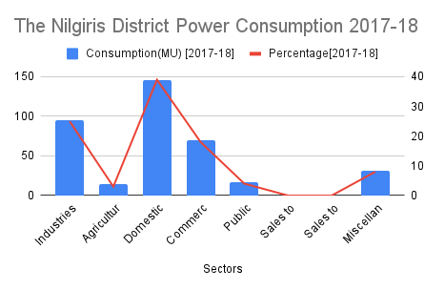
2017-18 District Wise Analysis
The analysis is based on a Sector wise power consumption on each district, to gather how much total consumption units are given to this district and also to get an insight of which area uses highest power resources.
The Graph represents here is for Nilgiris District.
The total power consumption in MU(i.e, Million Units) for this district is 373.74 MU and the sector which uses Highest power resource is Domestic with 39% of total consumed power resources.

Slide 7
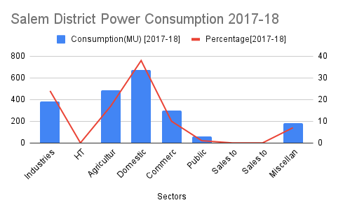
2017-18 District Wise Analysis
The Graph represents here is for Salem District.
The total power consumption in MU(i.e, Million Units) for this district is 2078.4 MU and the sector which uses Highest power resource is Domestic with 32% of total consumed power resources.

Slide 8
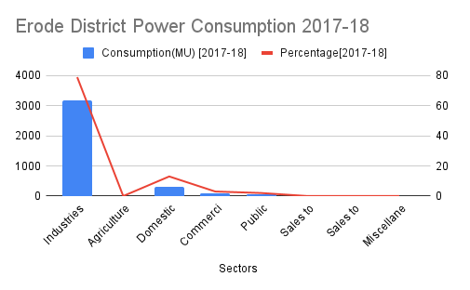
2017-18 District Wise Analysis
The Graph represents here is for Erode District.
The total power consumption in MU(i.e, Million Units) for this district is 3632.74 MU and the sector which uses Highest power resource is Industries with 88% of total consumed power resources.

Slide 9
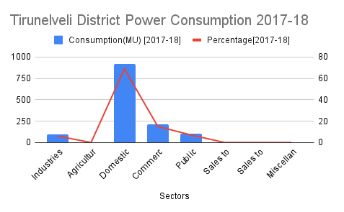
2017-18 District Wise Analysis
The Graph represents here is for Tirunelveli District.
The total power consumption in MU(i.e, Million Units) for this district is 1327.62 MU and the sector which uses Highest power resource is Domestic with 69% of total consumed power resources.

Slide 10
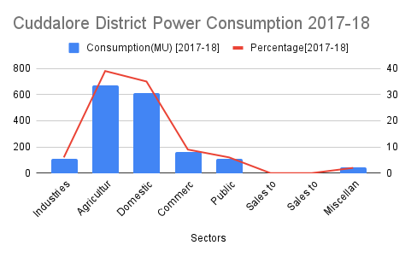
2017-18 District Wise Analysis
The Graph represents here is for Cuddalore District.
The total power consumption in MU(i.e, Million Units) for this district is 1327.62 MU and the sector which uses Highest power resource is Agriculture & Huts with 39% of total consumed power resources.

Slide 11
2017-18 District Wise Analysis - Inferences
Among the five districts namely The Nilgiris, Salem, Erode, Tirunelveli and Cuddalore , The highest power consumed district is Erode with 3632.74 MU.
The Sector which consumed the highest electricity among the five districts is Industries in Erode District.
And the sector common in other districts are mostly for Domestic purposes, which consumed the highest.
Only sector with Agriculture and Huts in Cuddalore District has consumed the highest power/electricty.

Slide 12
2018-19 District Wise Analysis

Slide 13
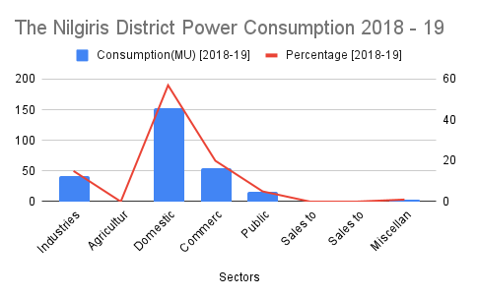
2018-19 District Wise Analysis
The analysis is based on a Sector wise power consumption on each district, to gather how much total consumption units are given to this district and also to get an insight of which area uses highest power resources.
The Graph represents here is for Nilgiris District.
The total power consumption in MU(i.e, Million Units) for this district is 268.29 MU and the sector which uses Highest power resource is Domestic with 57% of total consumed power resources.

Slide 14
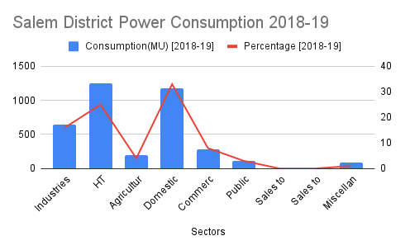
2018-19 District Wise Analysis
The Graph represents here is for Salem District.
The total power consumption in MU(i.e, Million Units) for this district is 3745.20 MU and the sector which uses Highest power resource is Domestic with 33% of total consumed power resources.

Slide 15
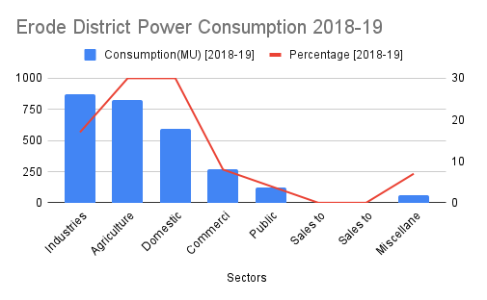
2018-19 District Wise Analysis
The Graph represents here is for Erode District.
The total power consumption in MU(i.e, Million Units) for this district is 2738.39 MU and the sector which uses Highest power resource is both Agriculture and Huts & Domestic with 30% of total consumed power resources.

Slide 16
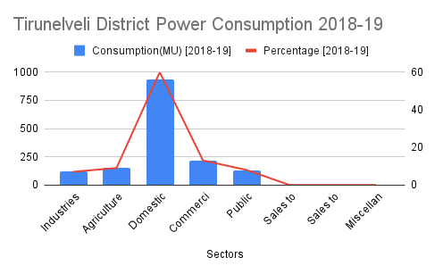
2018-19 District Wise Analysis
The Graph represents here is for Tirunelveli District.
The total power consumption in MU(i.e, Million Units) for this district is 1545.82 MU and the sector which uses Highest power resource is Domestic with 60% of total consumed power resources.

Slide 17
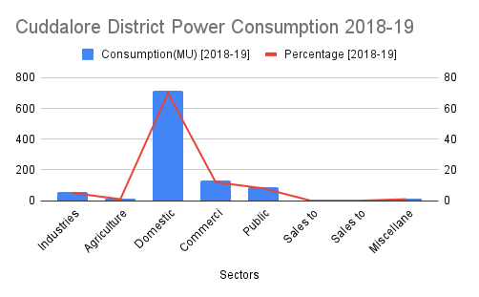
2018-19 District Wise Analysis
The Graph represents here is for Cuddalore District.
The total power consumption in MU(i.e, Million Units) for this district is 1018.23 MU and the sector which uses Highest power resource is Domestic with 70% of total consumed power resources.

Slide 18
2018-19 District Wise Analysis - Inferences
Among the five districts namely The Nilgiris, Salem, Erode, Tirunelveli and Cuddalore , The highest power consumed district is Salem with 3745.20 MU.
The Sector which consumed the highest electricity among the five districts is for Domestic purposes in The Nilgiris District.
The common sector is Domestic areas where the consumption took leading in all the individual districts.

Slide 19
Comparison Analysis between 2017-18 & 2018-19 Power consumptions

Slide 20
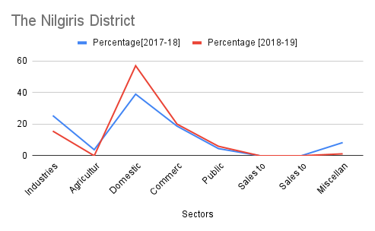
Comparison Analysis between 2017-18 & 2018-19 Power consumptions
2017-18 | 373.74 MU
2018-19 | 268.29 MU
The Graph represents here is for The Nilgiris District.
From the above table, power consumption in unit wise dropped by 39% (105.45 MU) from year 2017-18.
Sector wise , Domestic areas consumed more 46.15 % than previous year 2017-18 and still leading the first place as highest power consumer.

Slide 21
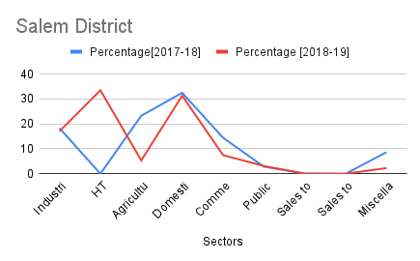
Comparison Analysis between 2017-18 & 2018-19 Power consumptions
2017-18 | 2078.4 MU
2018-19 | 3745.2 MU
The Graph represents here is for The Salem District.
From the above table, power consumption in unit wise increase by 80% (1666.8 MU) From 2017-18 Timeline.
Sector wise , Domestic aress dropped by 3 % than previous year 2017-18.
HT Services sector seen a rise from 0 to 33 % percentage from 2017-18 to 2018-19 total Consumptions.

Slide 22
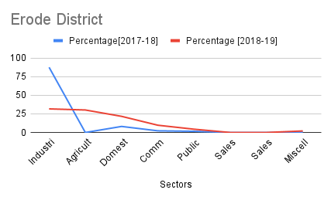
Comparison Analysis between 2017-18 & 2018-19 Power consumptions
2017-18 | 3632.74 MU
2018-19 | 2738.39 MU
The Graph represents here is for The Erode District.
From the above table, power consumption in unit wise dropped by 24.6% (894.35 MU) from year 2017-18.
Sector wise , Industries areas dropped by 63.6 % than previous year 2017-18 but still the highest power consuming sector.

Slide 23
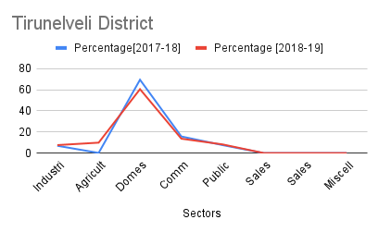
Comparison Analysis between 2017-18 & 2018-19 Power consumptions
2017-18 | 1327.62 MU
2018-19 | 1545.82 MU
The Graph represents here is for The Tirunelveli District.
From the above table, power consumption in unit wise consumed more by 16% (218.2 MU) from year 2017-18.
Sector wise , Domestic areas dropped by 11.6 % than previous year 2017-18 but still the highest power consuming sector.

Slide 24
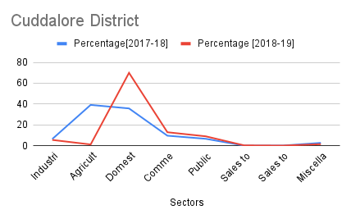
Comparison Analysis between 2017-18 & 2018-19 Power consumptions
2017-18 | 1715.38 MU
2018-19 | 1018.23 MU
The Graph represents here is for The Tirunelveli District.
From the above table, power consumption in unit wise seen a drop by 40.6% (697.15 MU) from year 2017-18.
Sector wise , Agriculture areas dropped by 97 % than previous year 2017-18 and Domestic areas took over in 2018-19 as the highest power consuming sector.

Slide 25
Comparison Analysis between 2017-18 & 2018-19 Power consumptions - Inferences
Among the five districts namely The Nilgiris, Salem, Erode, Tirunelveli and Cuddalore , Only Tirunelveli and Salem took increase in power/electricity consumption from 2017-18 to 2018-19 Timeline.

Slide 26
Choropleth Visualizations

Slide 27
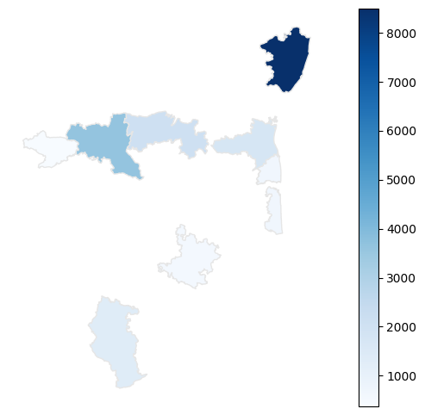
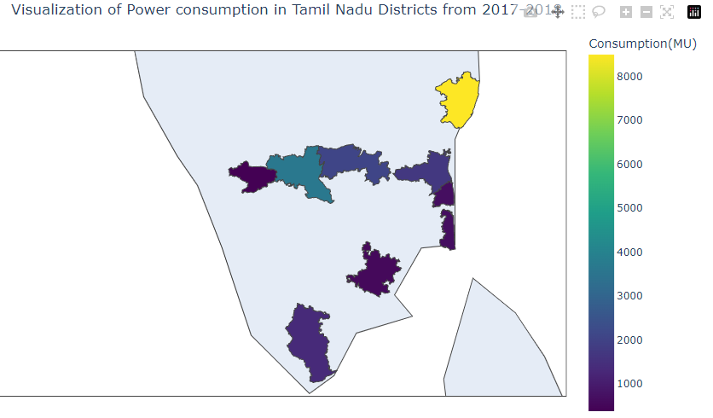
ChoroPleth Visualizations for 2017-18 Timeline
Choropleth map is used here for the visualization of the our results and analysis in the Tamil Nadu - District Boundaries Shapefile.
2017 - 2018 Visualization

Slide 28
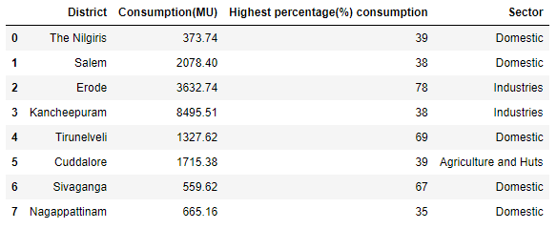
In the previous slide, the map visualizations are made for 8 Districts, the more power consumption has the dark color and less consumption has the light color.
Below is the tabular for the districts and their electricity consuming units.
Kancheepuram District taken as the highest power consumer in the year 2017-2018.

Slide 29
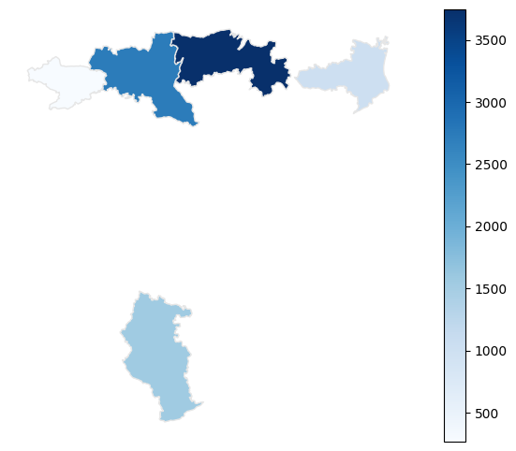
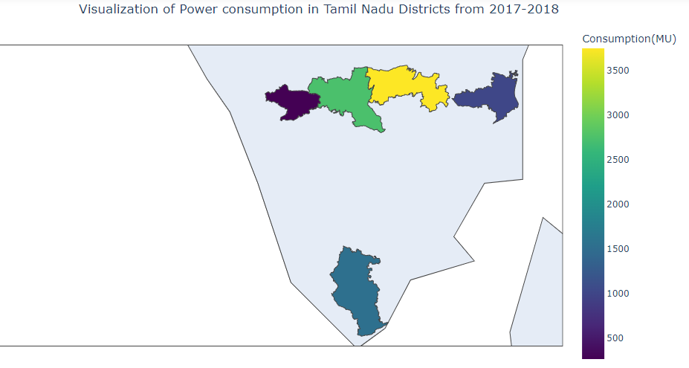
ChoroPleth Visualizations for 2018-19 Timeline
2018 - 2019 Visualization

Slide 30
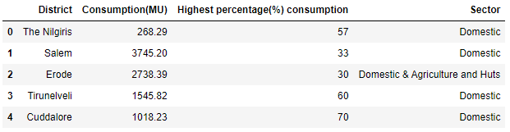
In the previous slide, the map visualizations are made for 5 Districts, the more power consumption has the dark color and less consumption has the light color.
Below is the tabular for the districts and their electricity consuming units.
Salem District taken as the highest power consumer in the year 2018-2019.

Slide 31
References and Links
Data available in https://data.gov.in/ and https://tn.data.gov.in/
Git Repository for the notebooks - https://github.com/praveen0222/District-Wise-Electricity-Consumption-Analysis-of-Tamil-Nadu-
Google sheets link of Chart Analysis - https://docs.google.com/spreadsheets/d/1jbXHenoJZQLGy53wL2fBye3vmSrFgnh49fdM_F-Vsw8/edit?usp=sharing
Tamil Nadu District boundaries shapefile - http://projects.datameet.org/maps/districts/

